Slide 1
Covex, LLC
HP ALM - Training

Slide 2
Training Outline:
What is HP ALM?
Benefits of HP ALM
User roles within HP ALM
What are the modules of HP ALM?
Modules, Sub-modules of HP ALM
Overview of HP ALM with screenshots

Slide 3
What is HP ALM?
The Quality Center software vendor Hewlett-Packard markets a suite of ALM applications and HP ALM is the primary application within their ALM suite
HP Application Lifecycle Management (HP ALM) is an electronic testing tool which is used to perform the following:
Create and Store Requirement Specifications
Create and Store Test Scripts
Execute Test Scripts
Create and Store Test Defects
Formerly known as HP QC, HP ALM is the newest version of this program
Note: Any of the following names are technically correct and can be used to refer to this application:
ALM / Quality Center / ALM QC / HP QC

Slide 4
Benefits of HP ALM
HP ALM is Web based
All required signatures are electronic in this system
It covers all essential aspects of test management
It assists project teams in all aspects of Application Lifecycle Management
HP ALM executing test script is far less time-consuming vs paper script based executions
In this system, Test Defect creating and tracking (linking the defects to test scripts) process is easier

Slide 5
User roles within HP ALM
HP ALM users’ list generally consist of people involved in development, management and testing of the application project. Following are examples of some of the user roles:
Release Manager:
Create and manage Releases and Cycles within HP ALM.
Requirement Author:
Creates and imports new requirements, which initiate the workflow process; notifies the start of the requirement review process by setting the approval status to “Routing for Approval”, or can set the status of a Requirement back to “In Progress” if that is needed.
Requirement Reviewer:
Reviews each requirement; can either reject or approve requirements.

Slide 6
User roles within HP ALM (continued)
Test Designer:
Create and manage Test Script entities.
Logically groups the Test Scripts together into folders or test sets.
Test Set Designers:
Test Set Designers marks each Test Set as “Ready for Execution” for the Testers.
Testers:
Execute Test Run entities within Test Lab or Test Run module.
Create defects as needed, linking each defect to the run.
Once the user completes the test run, they route that specific run to “Routing for Approval.”
Modify the run step status as needed.

Slide 7
User roles within HP ALM (continued)
Defect Author
Creates new defects by initiating the workflow process.
Once created, each defect will be assessed and completed by the author.
Defect Fixer/Defect Resolver
The Fixer/Resolver will resolve the defect (by providing fixes) and change the status to fixed or deferred; and place it in Ready for Review, which initiates the review process.
Defect Reviewer
The Reviewer reviews the defect and determines whether to reject or approve.
View Only
The viewer can only view certain aspects of a project and do not need to create, update, approve or reject entities.

Slide 8
What are the modules of HP ALM?
The following are all the different modules and sub-modules of HP ALM:
Dashboard
Analysis View
Dashboard View
Management
Releases
Libraries
Requirements
Testing
Test Resources
Test Plan
Test Lab
Test Runs
Defects
These modules, sub-modules, and their features, will be explained more in depth later in this presentation

Slide 9
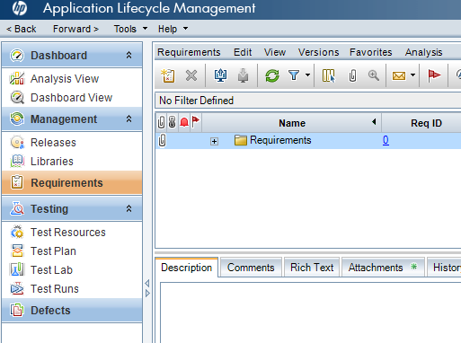
What are the modules of HP ALM? (continued)
The sidebar on the left side of the application window displays all the different modules within the application
Each of the modules covers a specific aspect of the application life cycle management process.
Note: screenshots of the overall application window are coming up later in this presentation.

Slide 10

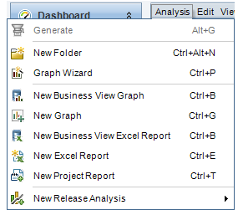
Dashboard Module
Analysis View Sub-Module
Create and organize all of the analysis items, which can consist of any of the following analysis types: Graphs Project Reports Excel Reports Note: Dashboard managers and administrators have complete access to the Analysis Menu tab; this enables them to manage the analysis items that are generated from the Analysis Menu in other modules (example: Requirements and Test Lab)

Slide 11
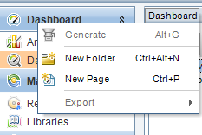
Dashboard Module (continued)
Dashboard View Sub-Module
Using HP ALM existing data, users can create: Graphs Standard Reports Excel Reports Note: Dashboard pages can also be created to display multiple graphs side-by-side

Slide 12

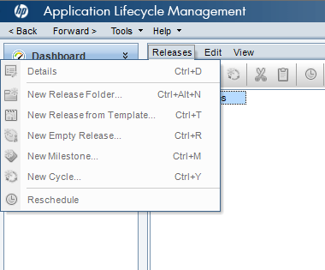
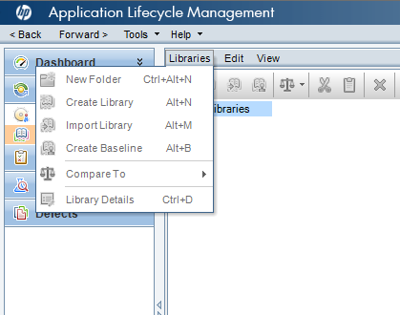
Management Module
Releases Sub-Module | Libraries Sub-Module
Using the Releases sub-module, a user can define releases and cycles for the application management process | Using Libraries Sub-Module, a user can define libraries to track changes in a project, reuse entities in a project, or share entities across multiple projects

Slide 13
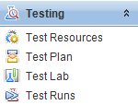
Testing Module
Testing Resources Sub-Module | Test Plan Sub-Module | Test Lab Sub-Module | Test Runs Sub-Module
Manage test resources in a hierarchical tree-structure Can be used to associate test resources with tests | Develop and manage tests in a hierarchical tree structure A repository of the test cases which are designed in adherence to the project’s user and functional requirements. Requirements and defects can be linked to test cases | Manage and run tests within the application Create test sets for executing manual and automated tests Collect evidence Combine evidence with test results Analyze the resulting data | Alternative way to perform many of the similar functions of the Test Lab sub-module

Slide 14
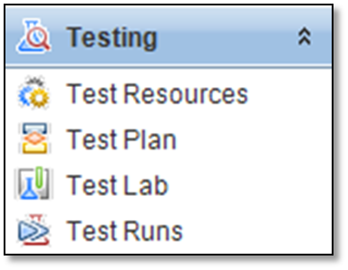
Test Plan Sub-Module’s Functionality:
Test Plan Sub-Module’s Functionality
Creating a Test Case - Test Case creation allows for modification of field values, add, edit, delete design steps, provide attachments, provide requirement traceability, and link defects.
Importing a Test Case - Allows for an Author to import one or more test cases to HP ALM from an external source (MS Excel).
Reviewing a Test Case - Allows for a reviewer(s) to approve the test case using E-Signature.

Slide 15
User roles within HP ALM
Test Plan sub-module related Roles:
Author - A group that can create or import the test cases.
Reviewer - A group that can review, approve, and reject newly created test cases.
Approver - A group that is accountable for ensuring the Test case meets the intended use.
Test Lead (Tech Unit/Business Owner) - First level of approval.
QA - Second level of approval.

Slide 16
Test Lab Sub-Module’s Functionalities:
Creating a Test Set -
A test set is a group of tests in a project designed to achieve specific project goals.
A Test Set Tree can be created in HP ALM which enables users to organize the application management process by grouping by folder.
Adding Test Instance to a Test Set - One or More approved test cases can be added from the test plan tree as instances to the test set.
Pre-execution Review - The author can request a pre-execution review by changing the status of the test set from Request to Open.
Approving a Test set - Allows Reviewer(s) to approve the test case using E-Signature.

Slide 17
Test Lab Sub-Module’s Functionalities (continued):
Executing a Test Set -
The Test Set is ready for execution after pre-execution approval.
The Executor(s) can run the test instances and submit the test set for post-execution review.
Post-execution Review - The executor requests a review of the execution by changing the status of the test set to Ready for Review.
Post-execution Approval - Once the reviewer(s) approve the test set, they must select the appropriate role assigned and submit the review outcome dialog box and the test set is closed.
Informal Testing - An informal test set can be created by moving the status test set from “New” to “Informal Test”; allows for execution of unapproved test cases.

Slide 18
User roles within HP ALM
Test Lab sub-module related Roles:
Author - A group that can create or test sets with test instances.
Executor - A group who is able to execute the test instances within the test sets.
Reviewer - A group who can perform pre-execution and post-execution approvals of test sets.
Approver - Test Lead (Tech Unit/Business Owner) - First level of approval.
QA – Second level of approval

Slide 19
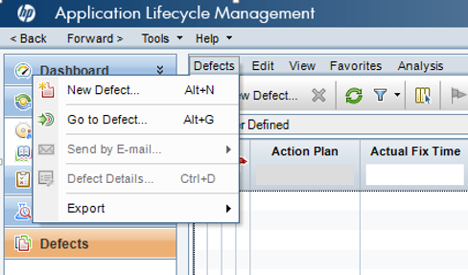
Defects Module
Additional information:
The Defect module enables a group to report defects to a project and keep track of the CAPA (Corrective and preventive action) process until the defects are resolved.
Defects can be linked to specific test steps within the test cases.
Defect Module’s Functionalities:
Creating a Defect - Defect creations include modification of field values, linking defects, and providing attachments.
Defect Review - The Author reviews the defect and the Fixer resolves the defect.
Defect Approval - The Reviewer rejects or approves the defect to close the defect workflow.
Defects Module
The Defect Module is used to: Create defects Track defects Prioritize created defects Resolve defects Analyze data

Slide 20
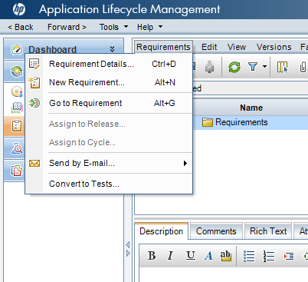
Requirements Module
Additional information:
The Requirement module allows for a group to define, manage, and track User and Functional Requirements at all stages of the system lifecycle.
New requirements can be created while existing requirements can be managed.
Requirements Module’s Functionalities:
Importing a New Requirement - New requirements can be imported using the excel add-in.
Requirement Approval - The reviewer reviews and approves the requirements, which allows for them to be linked to test cases.
Requirements Module
The Requirements Module is used to: Create requirements Manage requirements Link requirements to other requirements, tests or defects

Slide 21
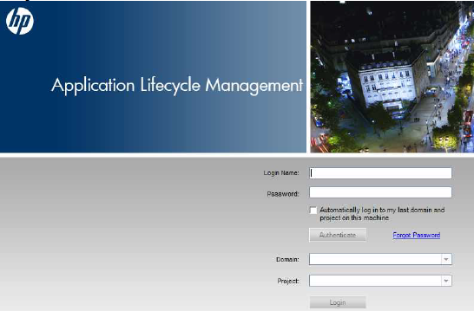
Overview of HP ALM with screenshots
On the right is the Quality Center / HP-ALM login screen:
In order to login successfully:
User needs to enter his/her credentials and click “Authenticate”
Select the correct Project from its Domain and click “Login”
After logging in, the upper right side of the window will display the following at all times:
The domain name
The project name
User’s name
“Logout” button
Note: The screenshots from the next slide on are a few of the most used windows by the Executor

Slide 22
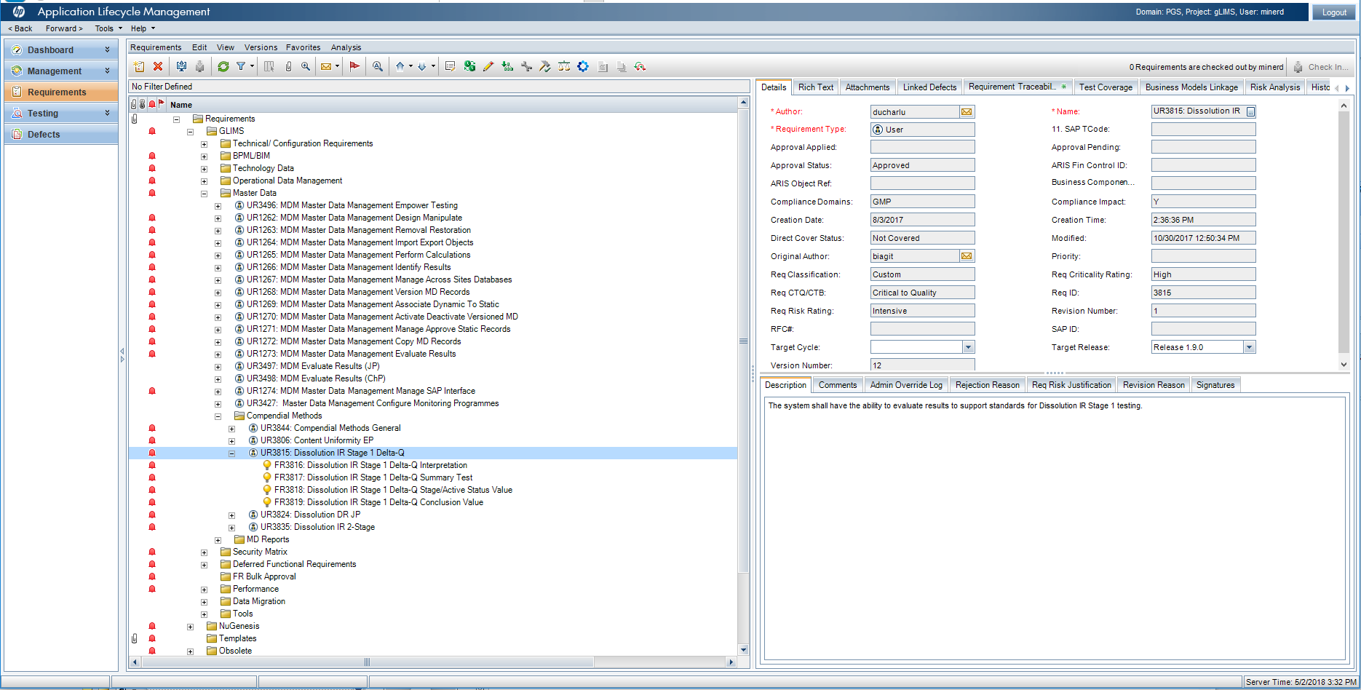
Screenshot of the “Requirements Module” window

Slide 23
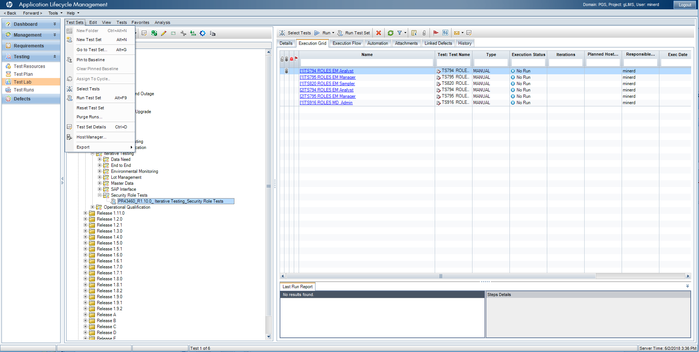
Screenshot of the “Test Lab Sub-Module” window

Slide 24
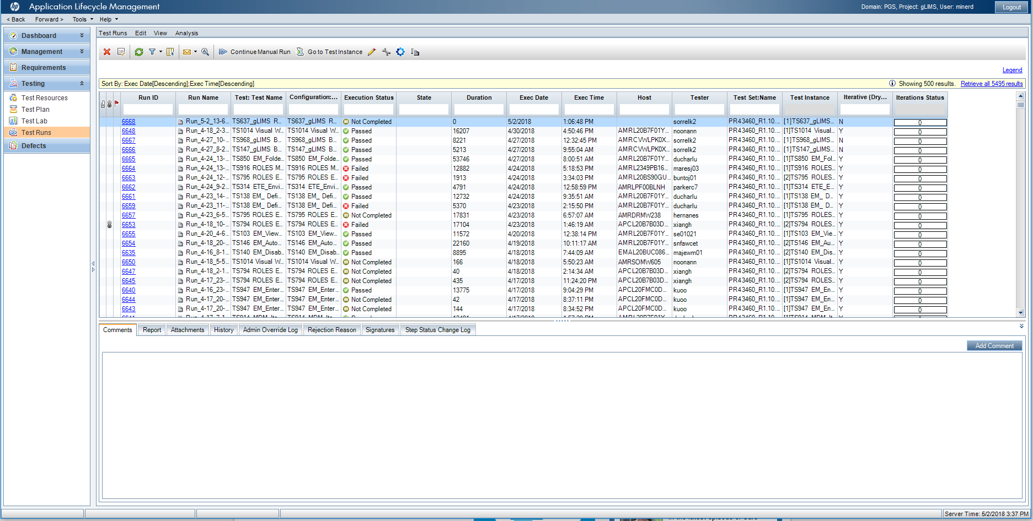
Screenshot of the “Test Runs Sub-Module” window

Slide 25
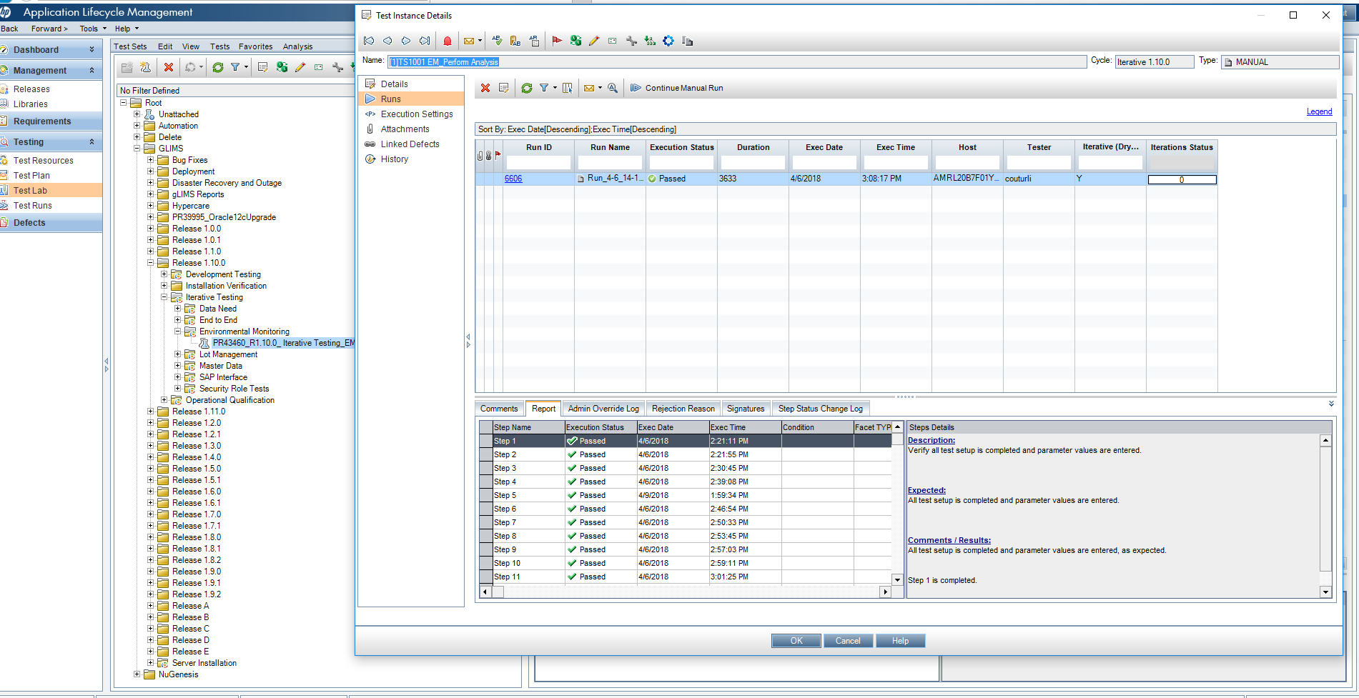
Screenshot of Test Instance Details under “Test Lab Sub-Module” – 1 of 2

Slide 26
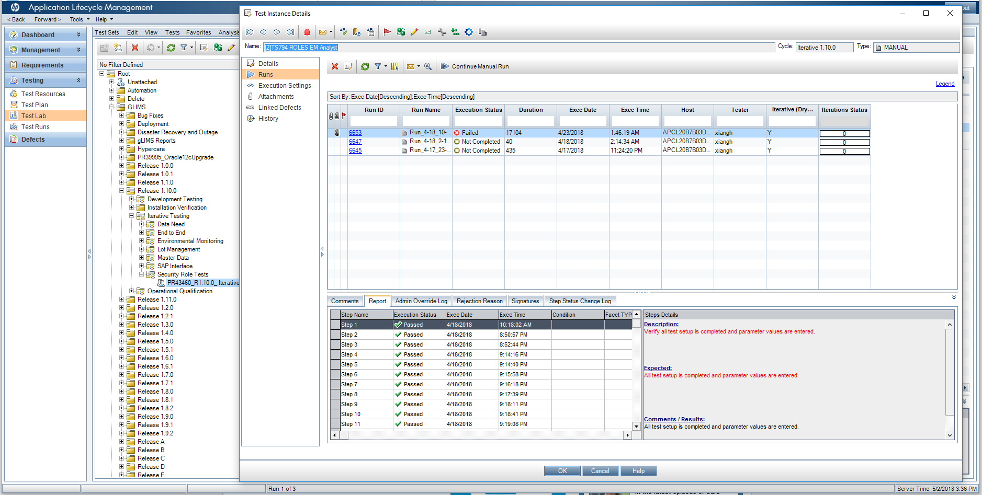
Screenshot of Test Instance Details under “Test Lab Sub-Module” – 2 of 2

Slide 27
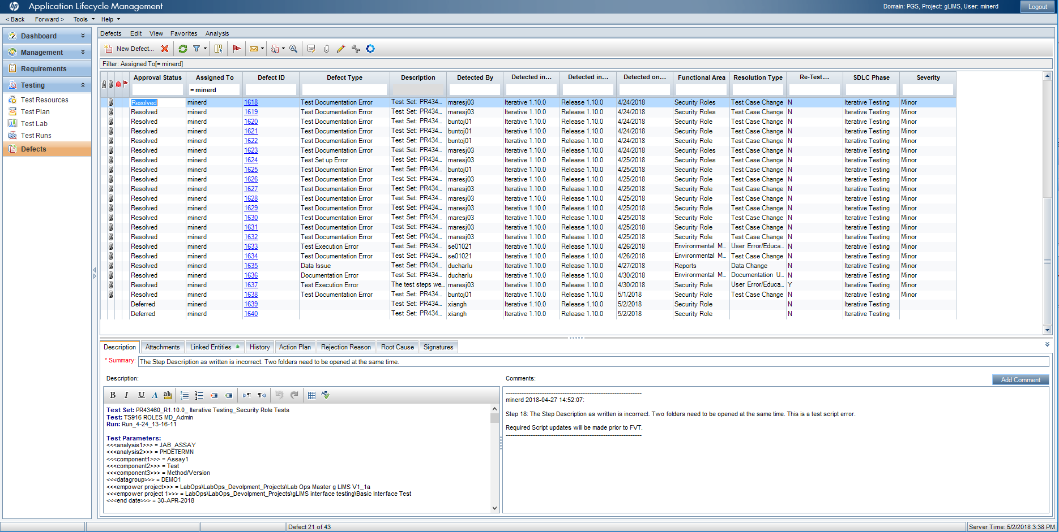
Screenshot of the “Defects Sub-Module” window

Slide 28
HP ALM Demo
Requirements
Test Plan
Test Lab
Defects

Slide 29

Questions?
COVEX, LLC

